Slide 1

CYBV474
Advanced Analytics for Security Operations
Week 7
Natural Language Part II – The amazing history of the
Natural Language Corpus

Slide 2


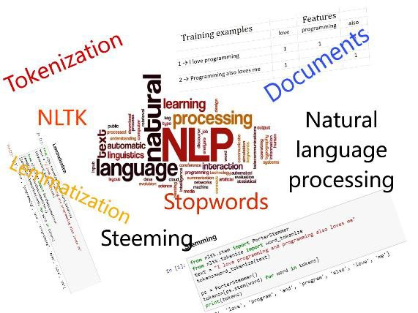



Agenda
A little history
Utilizing Advanced Natural Language Analysis
Your challenge this week :
Is to graph key characteristics of each candidate speech tendencies
POS Used by each candidate
TOP words used by each candidate

Slide 3
Read
Read Chapters 6, and 7 in the NLTK Book Online http://www.nltk.org/book_1ed/
Review and experiment with sklearn: https://scikit-learn.org/stable/
Watch
Watch the weekly videos
Week Seven Assignments
Participate in
Participate in this week's live lecture (or watch the replay, if you are unable to attend in person)
Complete
Complete this week's quiz
Complete
Complete this week’s assignment: Note: Make sure to Review the grading rubric prior to submission

Slide 4


Part of Speech Tagging
As we have experienced the Part-Of- Speech Tagger (pos_tag() in NLTK for example) is a software algorithm that reads text in from a specific language and assigns parts of speech to each word such as noun, verb, adverb, adjective, etc.

Slide 5

How did this come to be? Early Research in Corpus Linguistics
The first major corpus in English for computer analysis was the Brown Corpus developed at Brown University by Henry Kučera and W. Nelson Francis, in the mid-1960s.
The corpus consists of over 1 million words of English prose comprised from 500 samples extracted from varying publications. Each sample contains at least 2,000 words and only includes complete sentences.
The corpus was tagged by hand and the process took
several years.
Today the Corpus of Contemporary English contains over 100 million words.
NLTK contains words corpus from over 30 genres and categories with frequency distributions for each.
Today numerous tools are available that scrape the internet, social media, books, periodicals, news, movies, songs etc. to automatically create new tagged word corpuses.

Slide 6
from nltk import word_tokenize, pos_tag, FreqDist
from collections import Counter import re
Step one we have already accomplished
sampleText = 'thank you. We have to take a quick break.
When we come back, the Democratic Presidential Debate
continues right after this. Only on CBS'
''' Strip any punctuation '''
sampleText = re.sub("[^a-zA-Z ]", ' ', sampleText)
''' Part of Speech Tagging '''
words = word_tokenize(sampleText) # Tokenize text tags = pos_tag(words) # Part of Speech Tagging
''' tally each category'''
counts = Counter( tag for word, tag in tags)
fd = FreqDist(counts) # Calculate the distribution
fd.plot(title="Part of Speech Tagging Example")

Slide 7
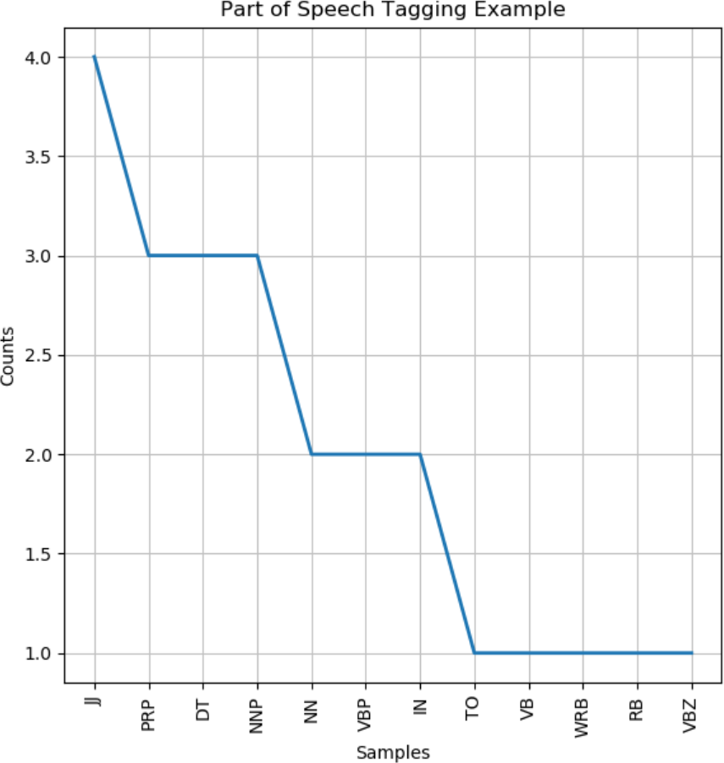
Sample Results
“thank you We have to take a quick break When we come back the Democratic Presidential Debate continues right after this Only on CBS”
[('thank', 'NN'), ('you', 'PRP'), ('We', 'PRP'), ('have', 'VBP'), ('to',
'TO'), ('take', 'VB'), ('a', 'DT'), ('quick', 'JJ'), ('break', 'NN'), ('When',
'WRB'), ('we', 'PRP'), ('come', 'VBP'), ('back', 'RB'), ('the', 'DT'),
('Democratic', 'JJ'), ('Presidential', 'NNP'), ('Debate', 'NNP'), ('continues', 'VBZ'), ('right', 'JJ'), ('after', 'IN'), ('this', 'DT'), ('Only', 'JJ'), ('on', 'IN'), ('CBS', 'NNP’)]
Counter({'JJ': 4, 'PRP': 3, 'DT': 3, 'NNP': 3, 'NN': 2, 'VBP': 2, 'IN': 2,
'TO': 1, 'VB': 1, 'WRB': 1, 'RB': 1, 'VBZ': 1})

Slide 8
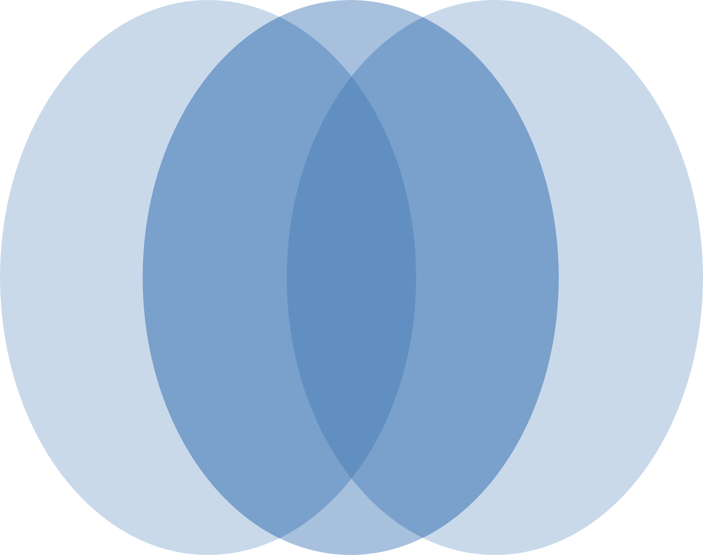
Questions?
Coming Up Next Week:
Natural Language Part III

